Slide 1
Numerical Methods in Engineering Research BIOL_EN 8180

Slide 2
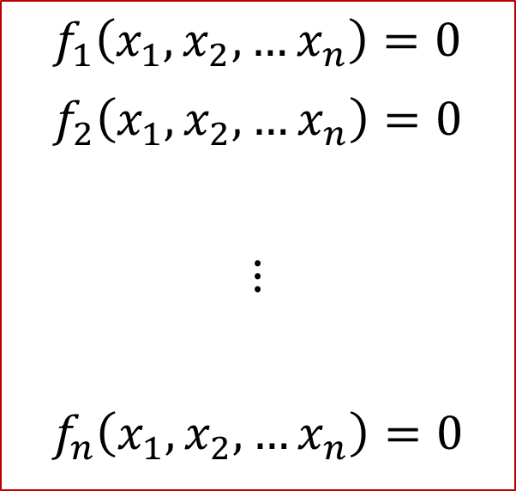
Introduction
Many practical problems in Engineering, Economics and Social Science lead to solving a system of linear equations of the form
Such system of equations can be
Linear, or
Nonlinear
Our focus here is the equations
Using R for solutions
We will use the package “matlib”
Examples
$$f_{1}\left(x_{1}, x_{2}, …x_{n}\right)=0$$
$$f_{2}\left(x_{1}, x_{2}, …x_{n}\right)=0$$
$$⋮$$
$$f_{n}\left(x_{1}, x_{2}, …x_{n}\right)=0$$

Slide 3
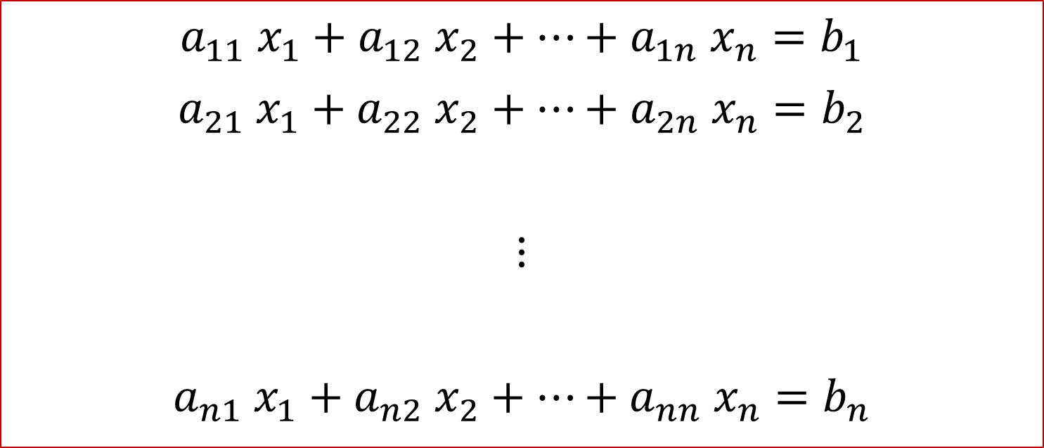
The System of Equations can be represented generally as:
$$a_{11} x_{1}+a_{12} x_{2}+…+a_{1n} x_{n}=b_{1}$$
$$a_{21} x_{1}+a_{22} x_{2}+…+a_{2n} x_{n}=b_{2}$$
$$⋮$$
$$a_{n1} x_{1}+a_{n2} x_{2}+…+a_{nn} x_{n}=b_{n}$$

Slide 4
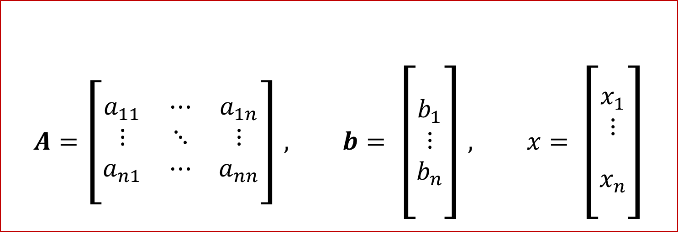

The System of Equations can be represented generally as:
$$A x=b$$
$$A=\left[\begin{matrix}a_{11} & ⋯ & a_{1n} \\ ⋮ & ⋱ & ⋮ \\ a_{n1} & ⋯ & a_{nn}\end{matrix}\right], b= \left[\begin{matrix}b_{1} \\ ⋮ \\ b_{n}\end{matrix}\right], x= \left[\begin{matrix}x_{1} \\ \begin{aligned}⋮ \\ \end{aligned} \\ x_{n}\end{matrix}\right]$$

Slide 5
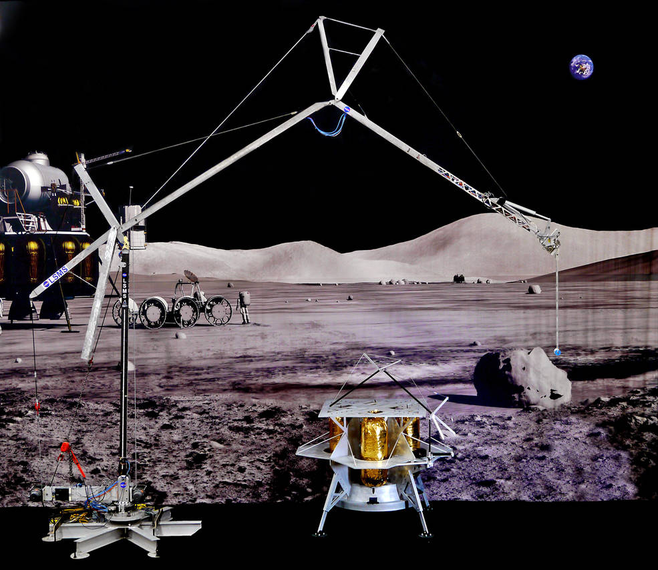
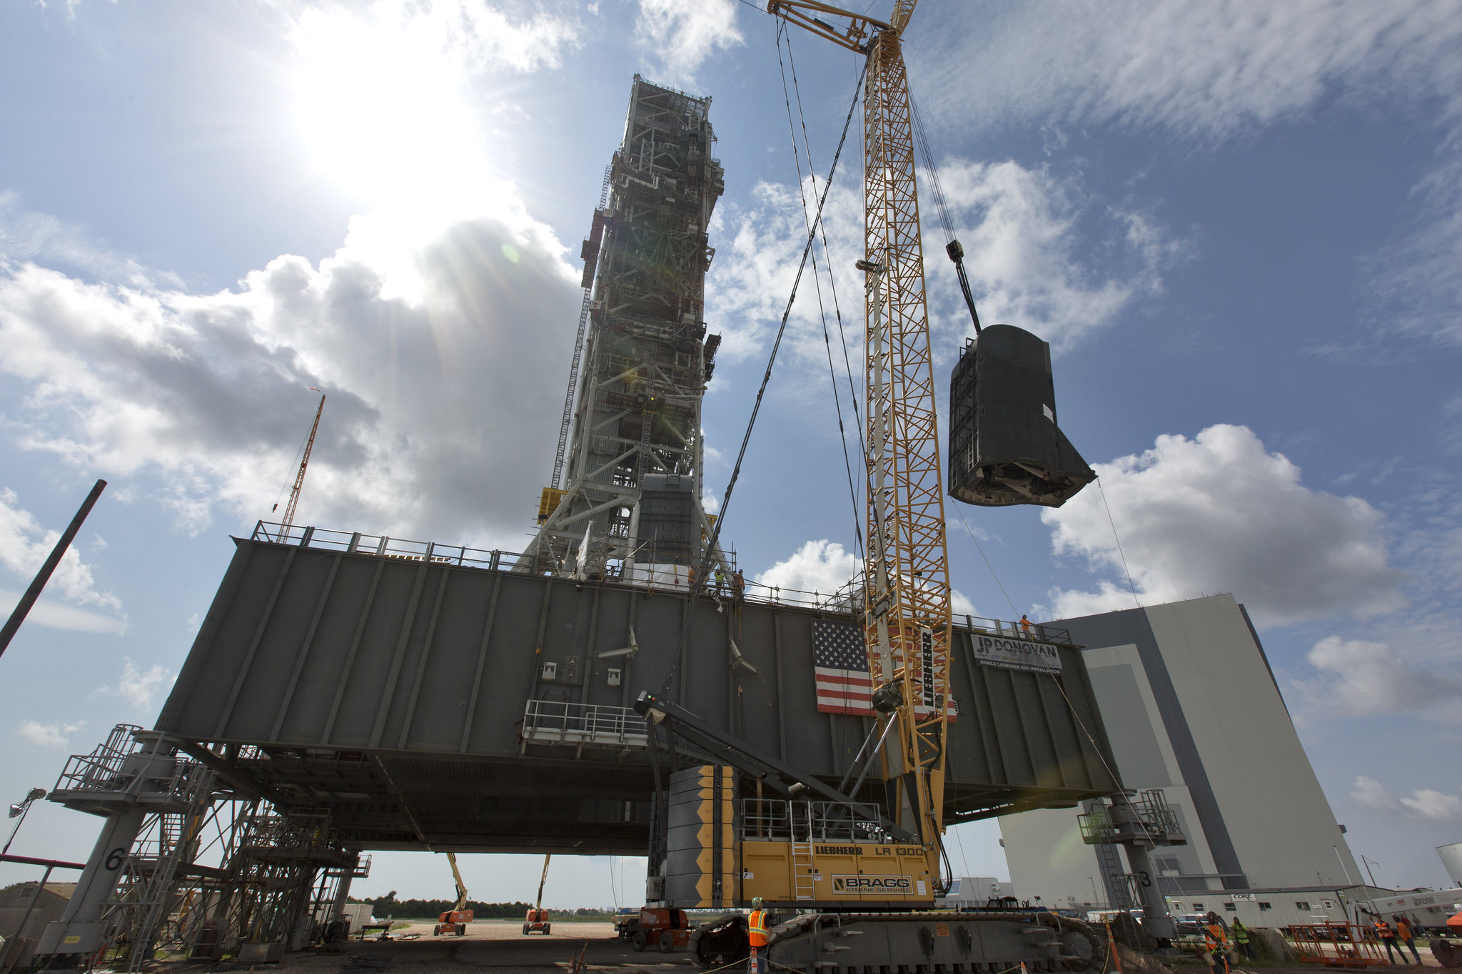
Examples: Crane Truss
Most construction work require a scaffolding system
Due to the complex nature of projects, scaffolding systems can vary by site
Notes:
NASA News Archives

Slide 6
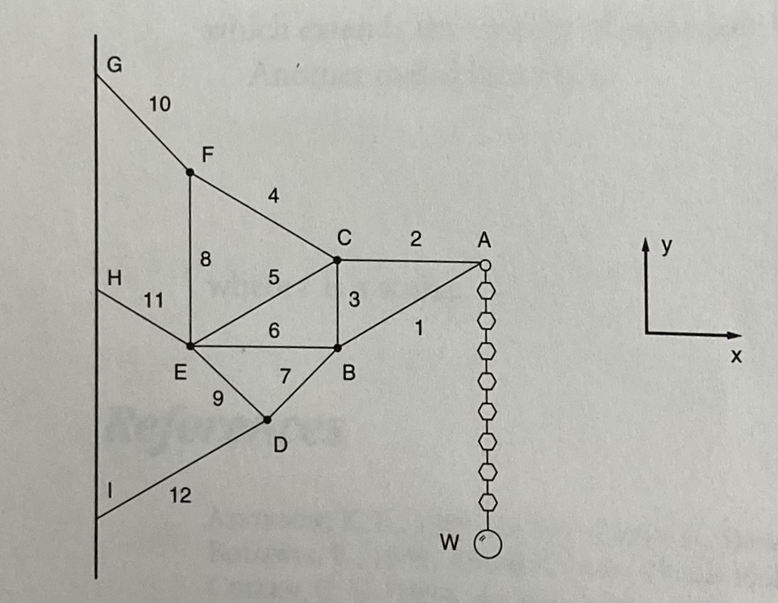
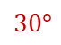
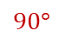
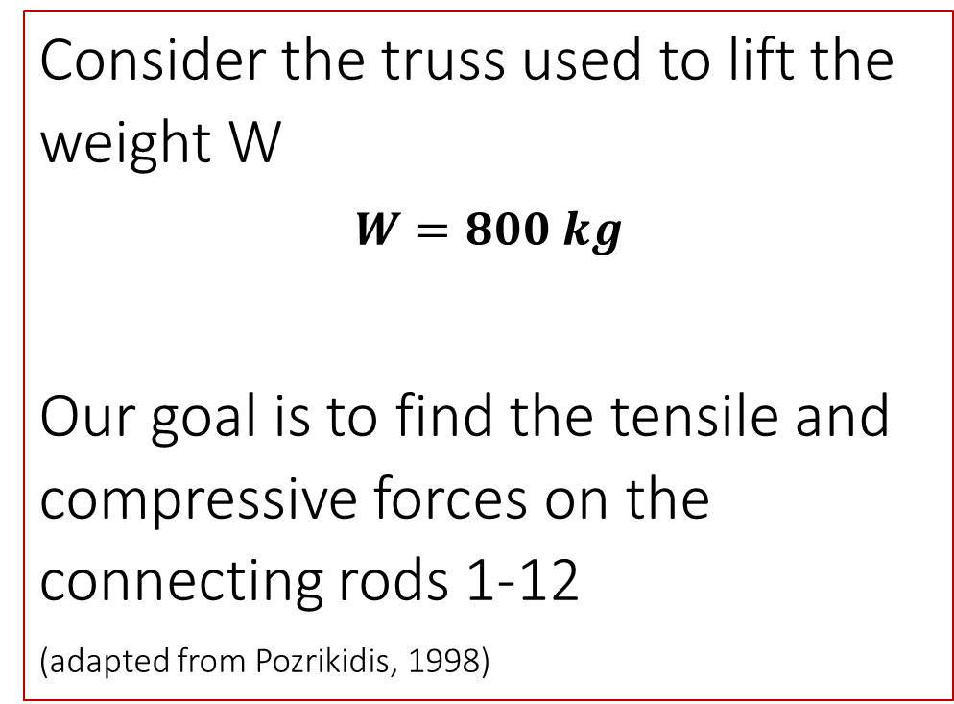
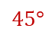
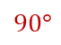
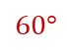
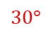
Example: Crane Truss
$$45°$$
Consider the truss used to lift the weight W
$$W=800 kg$$
Our goal is to find the tensile and compressive forces on the connecting rods 1-12
(adapted from Pozrikidis, 1998)
$$60°$$
$$60°$$
$$30°$$
$$60°$$
$$60°$$
$$60°$$
$$90°$$
$$45°$$
$$90°$$
$$45°$$
$$30°$$

Slide 7
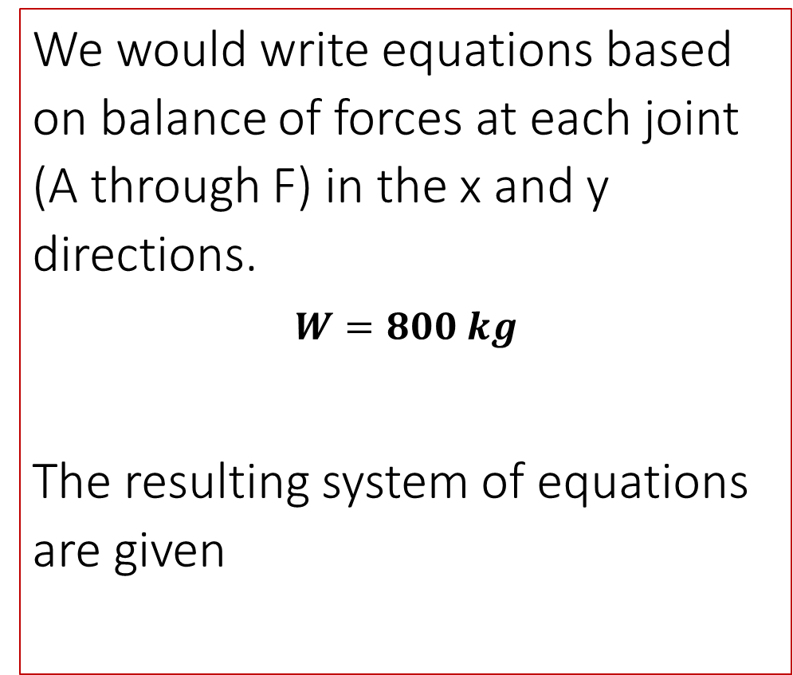
Example: Crane Truss
$$45°$$
We would write equations based on balance of forces at each joint (A through F) in the x and y directions.
$$W=800 kg$$
The resulting system of equations are given
$$60°$$
$$60°$$
$$30°$$
$$60°$$
$$60°$$
$$60°$$
$$90°$$
$$45°$$
$$90°$$
$$45°$$
$$30°$$

Slide 8
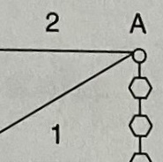
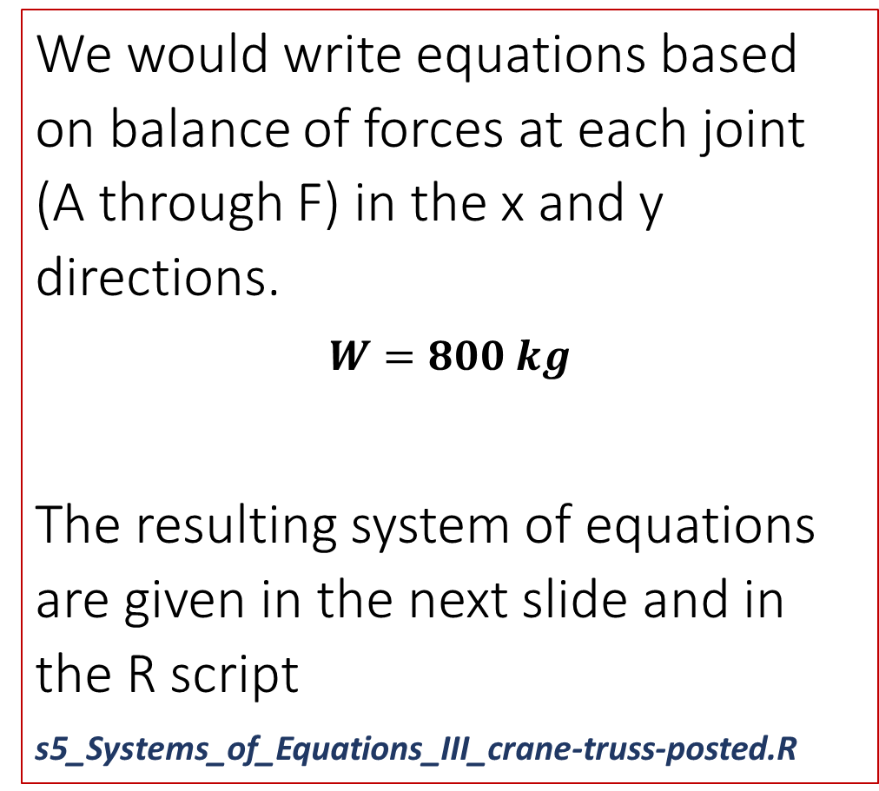
Example: Crane Truss
We would write equations based on balance of forces at each joint (A through F) in the x and y directions.
$$W=800 kg$$
The resulting system of equations are given in the next slide and in the R script
s5_Systems_of_Equations_III_crane-truss-posted.R

Slide 9
The System of Equations can be represented generally as:
$$A x=b$$
$$A=\left[\begin{matrix}a_{11} & ⋯ & a_{1n} \\ ⋮ & ⋱ & ⋮ \\ a_{n1} & ⋯ & a_{nn}\end{matrix}\right], b= \left[\begin{matrix}b_{1} \\ ⋮ \\ b_{n}\end{matrix}\right], x= \left[\begin{matrix}x_{1} \\ \begin{aligned}⋮ \\ \end{aligned} \\ x_{n}\end{matrix}\right]$$

Slide 10
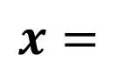
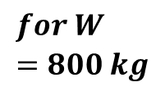
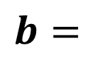
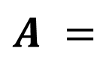
The System of Equations can be represented generally as:
$$A x=b$$
$$for W=800 kg$$
F1
F2
F3
F4
F5
F6
F7
F8
F9
F10
F11
F12
0
-800
0
0
0
0
0
0
0
0
0
0
$$A =$$
$$x=$$
$$b=$$
These are provided in the R script s5_Systems_of_Equations_III_crane-truss-posted.R

Slide 11
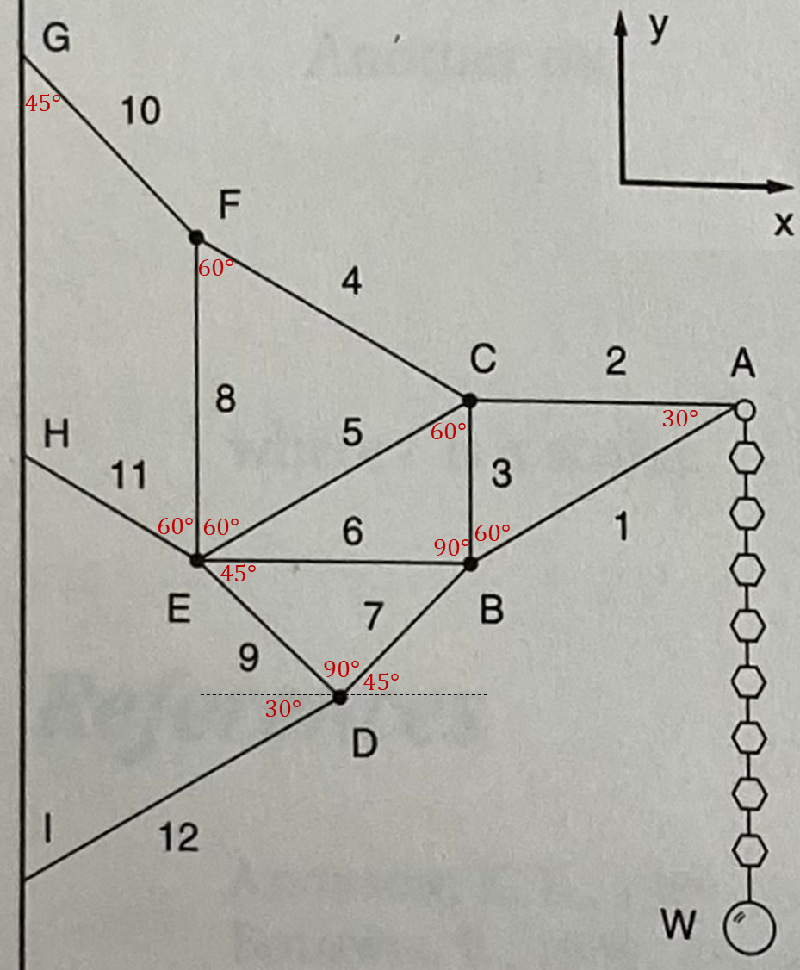
# ****************************************************
# 6) Answer the following questions !! ####
# ****************************************************
# 6.1) What is maximum tensile force on the rods?
# include the corresponding weight W
# 6.2) What is maximum compression force on the rods?
# include the corresponding weight W
# 6.3) If the allowable tensile and compression loads on the truss bars are
# 1600 kg and 1800 kg, respectively,
# What is the maximum safe weight the truss can handle?
# ****************************************************
# 7) Upload your script with answers and "RData" file to canvas !! ####
# ****************************************************
The System of Equations are provided in the R script s5_Systems_of_Equations_III_crane-truss-posted.R

